Slide 1
Project Management Introduction (H17D 34)
HNC Computing

Slide 2
Outline
Project Definition
Project Management Triangle
Work Breakdown Structure (WBS)
Project Management Methodologies
Project Stakeholders
Project Roles & Responsibilities
Brainstorming & Team Work
Project Planning, Scoping & Monitoring
Project Costing & Budgeting
Critical Path Analysis
Project Management Tools – MS Project, Gantt chart…
Class Exercises – Project Management Tasks

Slide 3
Part B: Project Planning Steps (Summary Notes)
Notes:
Q. Which of the WBS stage will you consider as the most important and least important during project management, and why? Explain your answers

Slide 4
Part B: Microsoft Project (Practical Exercises)
Notes:
Q. Which of the WBS stage will you consider as the most important and least important during project management, and why? Explain your answers

Slide 5
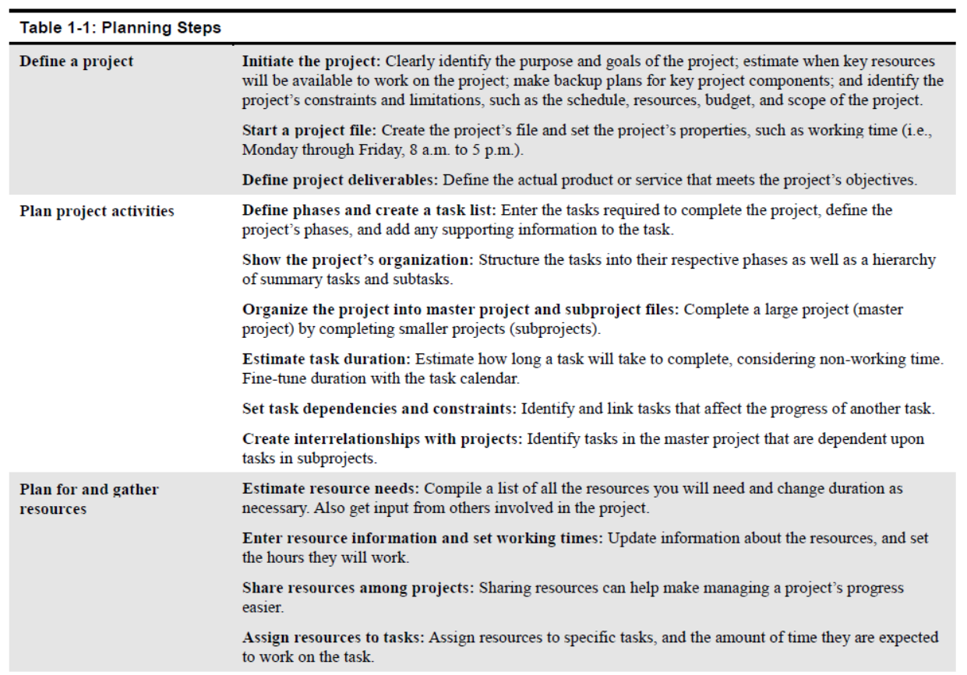
Project Planning steps - Summary
Notes:
Q. Which of the WBS stage will you consider as the most important and least important during project management, and why? Explain your answers

Slide 6
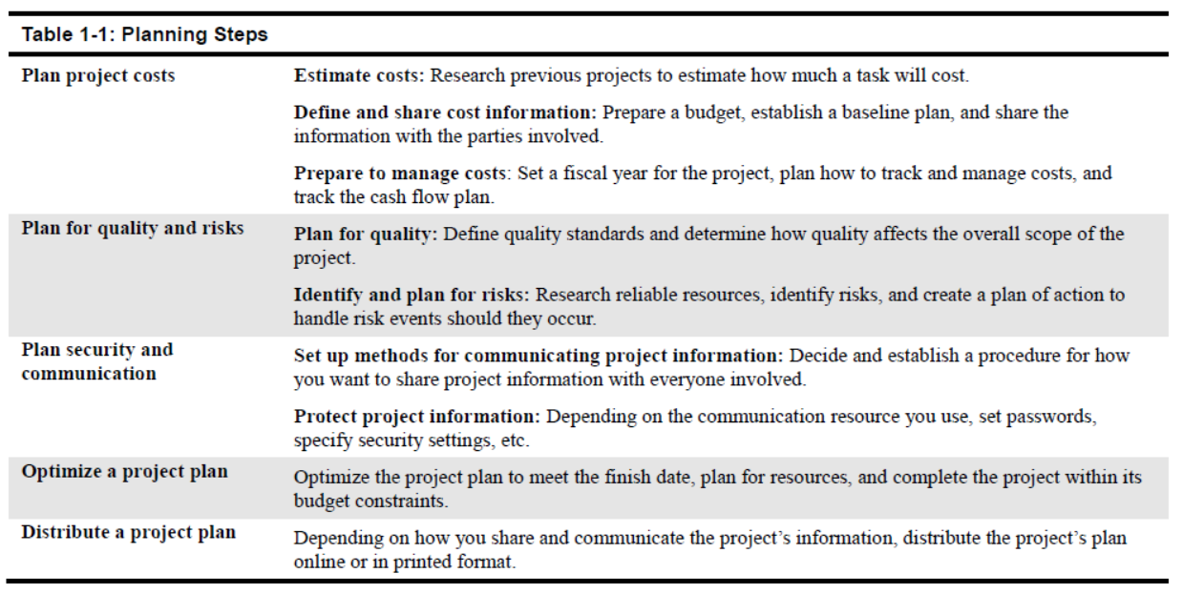
Project Planning Steps - Summary
Notes:
Q. Which of the WBS stage will you consider as the most important and least important during project management, and why? Explain your answers

